Slide 1

Objective
Bharat store wants to create an annual sales report for 2022. So that, Bharat can understand their customers and grow more sales in 2023.

Slide 2
Sample Questions
Compare the sales and orders using single chart
Which month got the highest sales and orders?
Who purchased more- men or women in 2022?
What are different order status in 2022?
List top 10 states contributing to the sales?
Relation between age and gender based on number
Which channel is contributing to maximum sales?
Highest selling category?, etc.

Slide 3
Steps taken in analyzing data
My objective was to analyze sales data for our company and identify trends and patterns that could inform our sales
strategy moving forward.
I collected sales data from our CRM system and organized it int a structured format using Excel's table feature.
I cleaned the data by removing duplicate entries, correcting errors, and filling in missing data points.
Using Excel's built-in functions and formulas, we calculated key metrics such as total revenue, average sale amount, and
sales by product category.
I created several charts and graphs, including a line chart showing sales over time and a pie chart showing sales by
product category, to help us visualize the data and identify trends.
To summarize and analyze the data more easily, we used Excel's PivotTable and PivotChart features to create a pivot
table that allowed us to group sales data by month, product category, and sales representative.
I combined our charts and graphs into a single dashboard that provided a quick overview of key metrics and trends,
including total revenue, top selling products, and sales by region.
I used conditional formatting to highlight important data points and trends, such as changes in revenue or sales performance
compared to previous periods.
I made sure the dashboard was easy to read and visually appealing by using consistent formatting and color schemes, and by
organizing the data in a logical and intuitive way.i
I tested the dashboard to ensure it was working as intended and updated it regularly to reflect changes in our sales data.

Slide 4
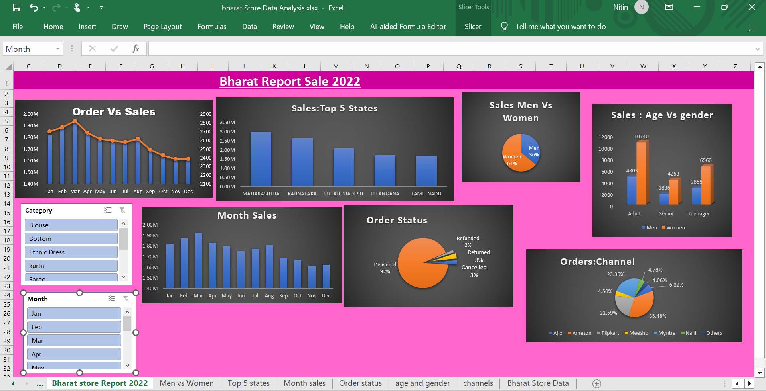
Report

Slide 5
Sample Insights
Women are more likely to buy compared to men (65%)
Maharashtra, Karnataka and Uttar Pradesh are the top 3
Adult age group (30-49 yrs) is max contributing (~50%)
Amazon, Flipkart and Myntra channels are max contribution
Final Conclusion to improve Bharat store sales:
Target women customers of age group (30-49 yrs) living in Maharashtra, Karnataka and Uttar Pradesh by showing ads/offers/coupons available on Amazon, Flipkart and Myntra

